Slide 1

My journey

Slide 2

1

Slide 3
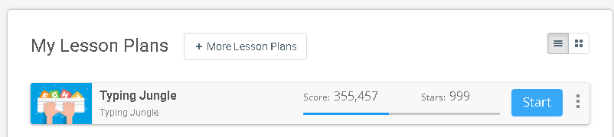
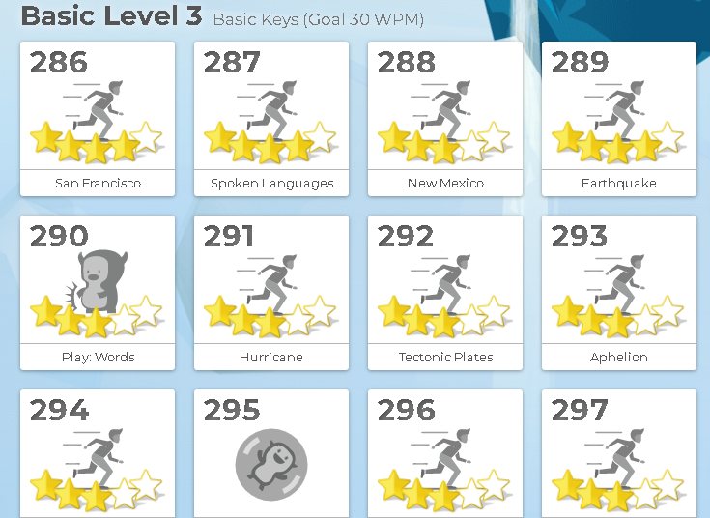

Slide 4
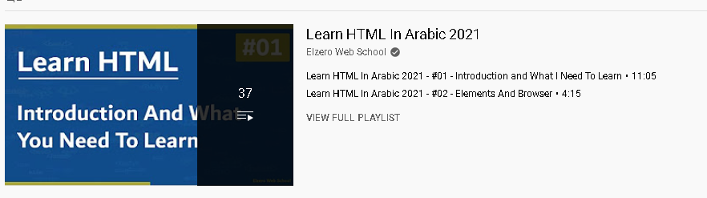
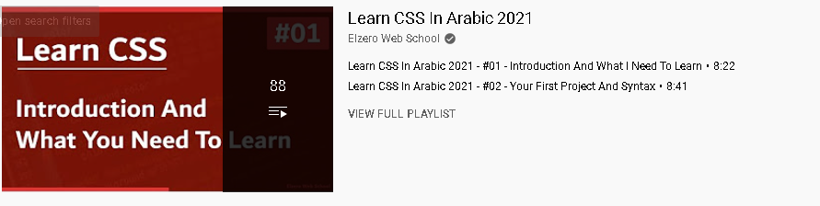

Slide 5

2

Slide 6
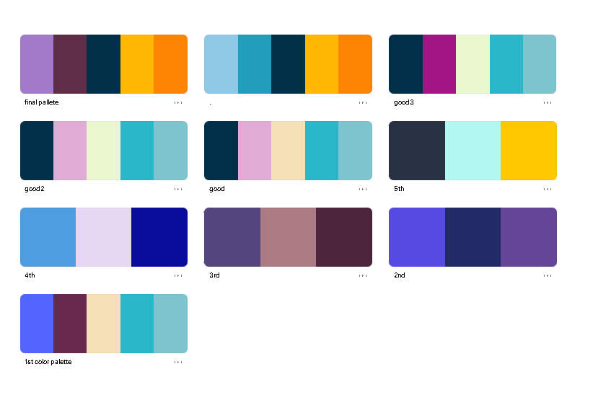

Slide 7


Slide 8


Slide 9

Further steps

Slide 10


Slide 11


